Slide 1

OLSRv2 Simulation for MANET
First report presentation

Slide 2
Agenda
Project Description
The first report
Optimized Link State Routing Protocol Ver. 2
Main modules
Fields of expansion
Schedule
Questions and open discussion

Slide 3
Project Description
Simulating MANET environment implementing OLSRv2 protocol
Event Driven Simulator
Special interest at different Topology layouts
Output:
Network’s throughput
Average of hops per data packet

Slide 4
Project Description
Project Output:
Throughput comparison between number of different Topology layouts
Throughput comparison between different MPR sets selection (minimal Vs maximal)
Scalability
Network reliability

Slide 5
The First Report
Introduction
NHDP
OLSRv2
Project Description
Goals
Output
General Layout

Slide 6
The First Report
Main Modules
Main Algorithms
Event generation and manipulation
Throughput Analysis
Appendixes
Estimated project timetable
Requirements
Screens shots

Slide 7
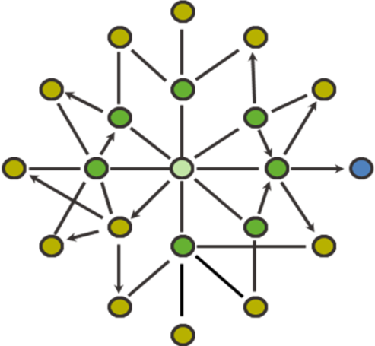
Optimized Link Status Protocol
Based on 1-hop & 2-hop Neighbors sets
Multi Point Relay set

Slide 8
Optimized Link Status Protocol
MPR
Each node notifies its MPR set for their nomination
MPRs broadcast their new role
All nodes can now build a routing table
MPR
Target
MPR
MPR
MPR
Source
MPR

Slide 9
Main Modules

Slide 10
Fields of Expansion
Topology Mobility
Secondary MPR sets
Connection quality (Topology constrains)

Slide 11
Schedule
18.11.2009 – First Report Submission
25.11.2009 – First Report Feedback
30.12.2009 – Project Review
15.1.2010 - Project Presentation and Final Report Submission

Slide 12
Questions
&
Open Discussion

Slide 13
Thank you !
Assaf Israel
Eli Nazarov
Asi Bross

